Slide 1


To Invest or Not
Catherine Bui

Slide 2

Today – December 2, 2019
Stock market just opens

Slide 3
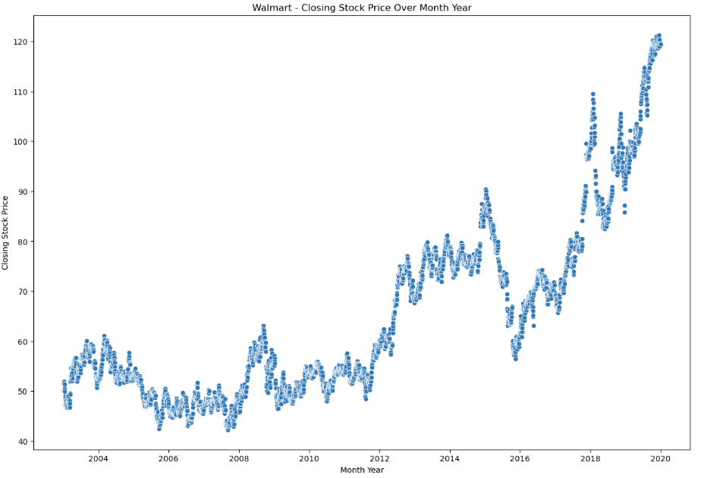
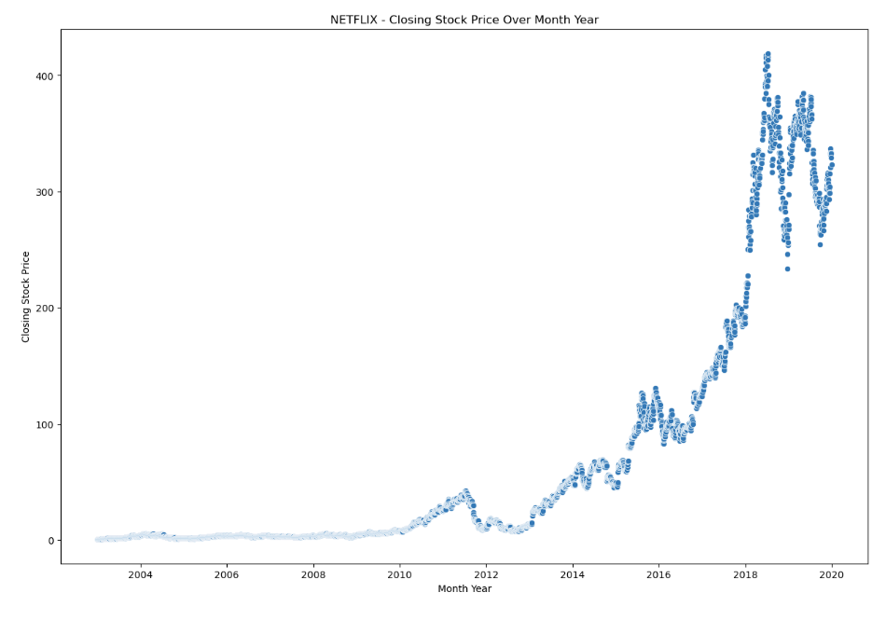
Historical Price Trend from 2003-2019
Upward Price Trend
Walmart
Netflix

Slide 4
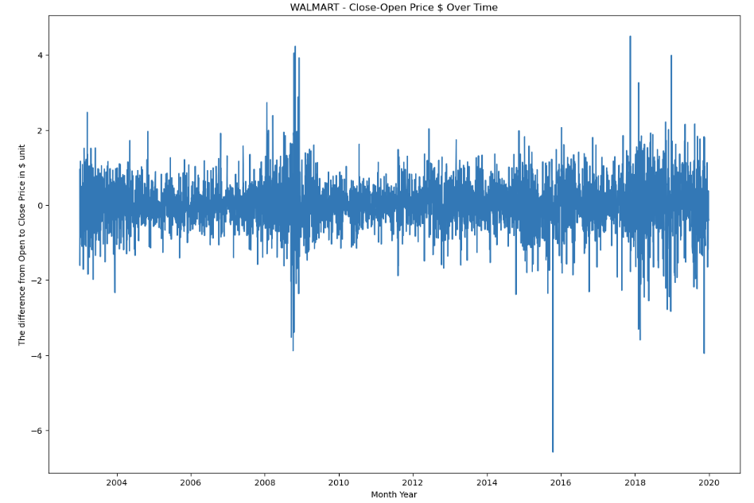
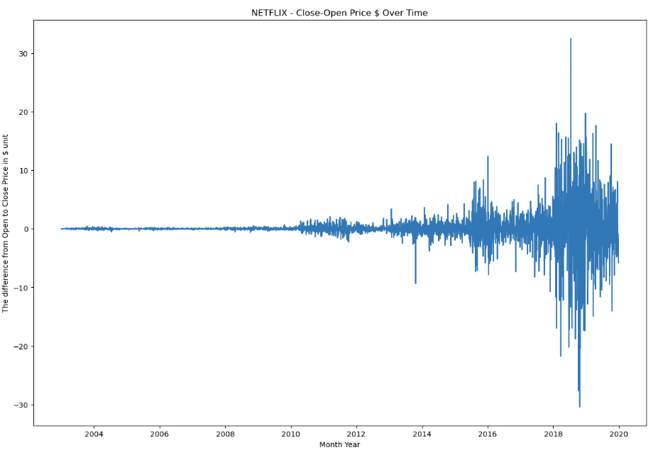
How much ($) is the stock moving daily?
Relatively Stable
Price Boom in 2012
Walmart
Netflix

Slide 5
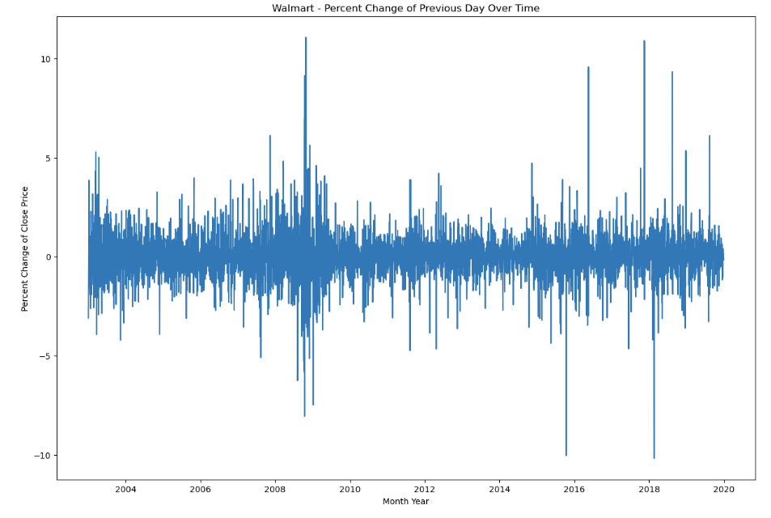
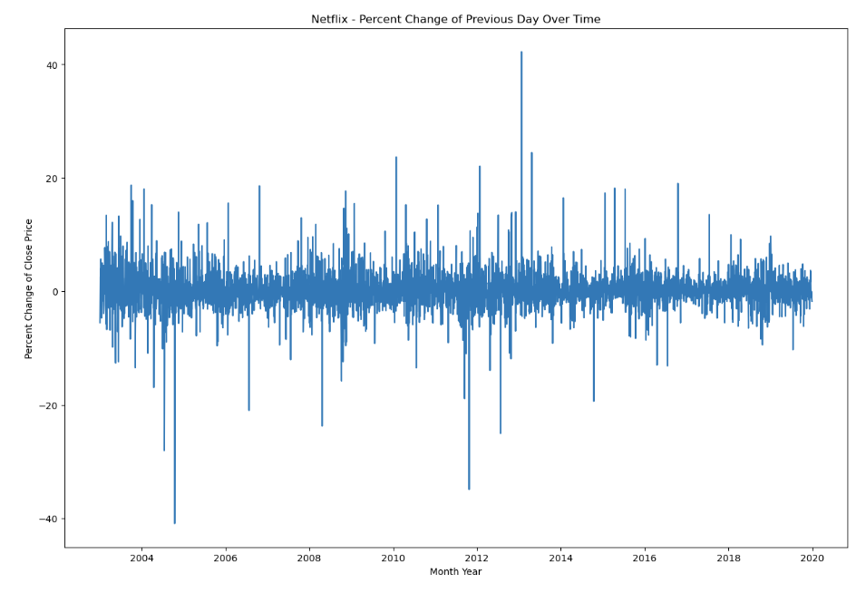
How volatile is the daily percent change?
Volatility: ±10 %
Volatility: ±40 %
Walmart
Netflix

Slide 6
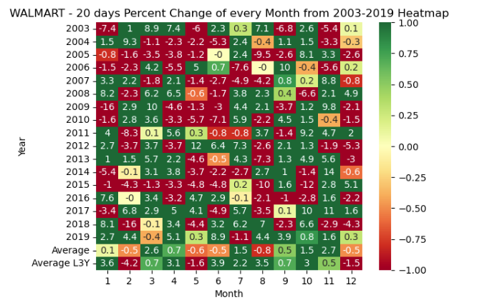
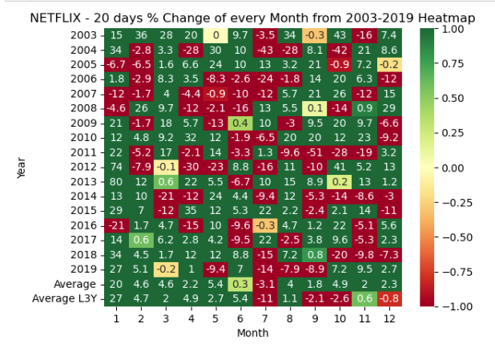
On avg, will stock go up or down in December?
Down by -0.5%
Up by 2.3%
Walmart
Netflix

Slide 7

Machine Learning
Predicting Stock Price

Slide 8
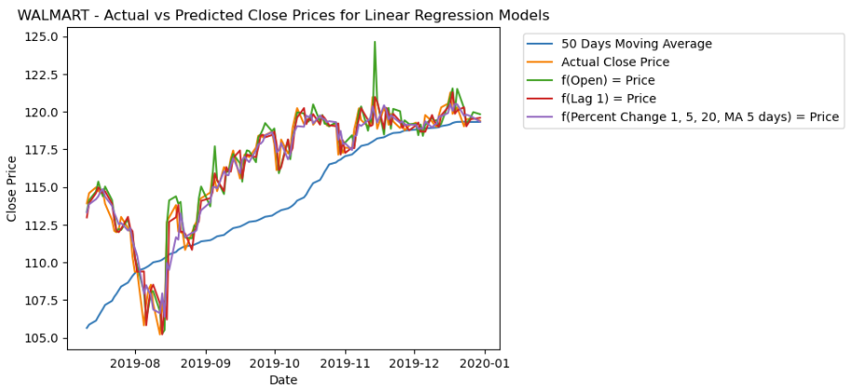
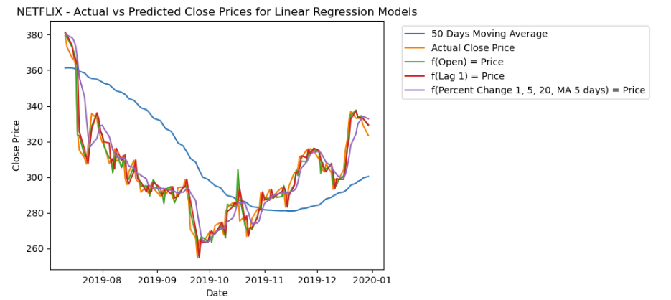
What is the predicted stock price trend in Dec?
Up and Down
Down and Up
Walmart
Netflix

Slide 9
What is the predicted stock price on Dec 2, 2019?
WALMART
NETFLIX
Predicted: $119.14
Actual: $119.28
MSE: 0.02
Predicted: $314.51
Actual: $309.9
MSE:9.09

Slide 10

Machine Learning
Predicting Stock Direction

Slide 11


Prediction: Stock Price Direction Today
WALMART
TARGET

Slide 12
Prediction: Stock Price Direction Tomorrow
WALMART
TARGET

Slide 13

Today’s Investment Decision
Do not Invest in Walmart Today
Stable predictable stock price
Upward price trend
Predicted stock trend today: Up
Predicted stock trend tomorrow: Down
Do not invest in Netflix Today
Volatile stock price
Big Risk Big Rewards
Upward price trend
Predicted stock trend today: Down
Predicted stock trend tomorrow: Down

